Slide 1
Final Project - Simple Microprocessor -
Logic Design Lab.
Spring 2018
Prof. Chang-Gun Lee
(cglee@snu.ac.kr)
TA. WonJae Jang
TA. Wonseok Lee
TA. Alena Kazakova
TA. Dongwan Kang
(ta@rubis.snu.ac.kr)

Slide 2
Contents
Project Overview
Microprocessor Design
Data Path
Instruction Set Architecture
Formats of the entire instruction set
Control Signal Table
Interface of Microprocessor components
Example test set : Input/Output
Test Environment
Project Grading

Slide 3
Project Overview
Implement a Simple Microprocessor in Verilog and program it on FPGA. Mimic a real computer.
Your FPGA implementation should consist of an ALU, a control unit, a system memory, registers, and so on.
Use the on-board 50MHz clock oscillator to create 1Hz clock (1 tick per second).
RUBIS
3

Slide 4
Project Overview
8-bit Microprocessor
Instruction size : 8-bit
# of instructions : 4 (add, load, store, jump)
Register size : 8-bit
# of registers : 4
Input : Instruction codes from external memory (TA’s FPGA)
TA will test the result with the memory implemented in another FPGA chip. Several sets of instruction codes will be tested. Specific pin assignments between your microprocessor and instruction memory will be given.
Output : Current value of Reg Write Data.
Use 7 segment displays. Display the value in Hexadecimal.
※ David A. Patterson, John L. Hennessy. (2005). Computer Organization and Design (3rd ed.). Morgan Kaufmann.
RUBIS
4

Slide 5
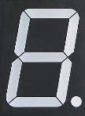
Microprocessor Design – Data Path
1
Add
MUX
0
Add
1
Control
Branch
MemtoReg
MemRead
MemWrite
Instruction [7:6]
ALUOp
ALUSrc
RegWrite
RegDst
Registers
Instruction [5:4]
Read Register1
Read data1
ALU
PC
Instruction [3:2]
MUX
Read Register2
0
MUX
MUX
0
Write Register
0
1
Read data2
External Memory
1
Reg Write Data
1
Instruction [1:0]
Data Memory
Instruction Memory
Sign
extend
Read Address
Address
Instruction [7:0]
Output
Read Data
Write Data

Slide 6
Microprocessor Design - Instruction Set Architecture
Formats of the entire instruction set
(8bit processor)
* op |  | operation code |  |  |  |  |  |  |  | * Registers (8bits)
rd |  | destination register |  |  |  |  |  |  |  | Program Counter(PC)
rs |  | source register |  |  |  |  |  |  |  | $s0 - $s3
rt |  | source register two
imm |  | immediate (constant) |  |  |  |  |  |  |  | * Memories (8bits)
 |  |  |  |  |  |  |  |  |  | Instruction Mem. | address range: 0x00-0xFF
op, rd, rs, rt |  | unsigned value |  |  |  |  |  |  |  | Data Mem. | address range: 0x00-0xFF
imm |  | signed value
Machine Code
CMD | Type | Example |  |  |  |  |  |  |  | Meaning (Assembly Code) | Meaning (in C language) | Description
 |  | 7 | 6 | 5 | 4 | 3 | 2 | 1 | 0
 | R | op |  | rs |  | rt |  | rd
 | I | op |  | rs |  | rt |  | imm
 | J | op |  |  |  |  |  | imm
add | R | 0 |  | 1 |  | 2 |  | 0 |  | add $s0, $s1, $s2 | $s0 = $s1 + $s2 | 3 operands, add with registers
lw | I | 1 |  | 3 |  | 0 |  | 0 |  | lw $s0, 0[$s3] | $s0 = Mem[$s3+0] | transfer value from memory to reg.
sw | I | 2 |  | 3 |  | 0 |  | 1 |  | sw $s0, 1[$s3] | Mem[$s3+1] = $s0 | transfer value from reg. to mem.
j | J | 3 |  |  |  |  |  | -2 |  | j -2 | go to (next PC -2) | jump to next PC with an offset
※ for Add operation, you don't have to care about the overflow.
※ only the immediate is signed value, other values are unsigned

Slide 7
Microprocessor Design - Instruction Set Architecture
Control Signal Table
Signal Name | Effect when deasserted (0) |  |  |  | Effect when asserted (1)
RegDst | The register file destination number for the Write register comes from the rt field (bits4-5) |  |  |  | The register file destination number for the Write register comes from the rd field (bits2-3)
RegWrite | None |  |  |  | Write result to rd
ALUSrc | The second ALU operand comes from the second register file output (Read data 2) |  |  |  | The second ALU operand is the sign-extended, lower 2 bits of the instruction
Branch | The PC is repaced by the output of the adder that computes the value of PC + 1 |  |  |  | The PC is repaced by the output of the adder that computes the branch target
MemRead | None |  |  |  | Data memory contents designated by the address input are put on the Read data output
MemWrite | None |  |  |  | Data memory contents designated by the address input are replaced by the value on the Write data input
MemtoReg | The value fed to the register Write data input comes from the ALU |  |  |  | The value fed to the register Write data input comes from the data memory
ALUOp | None |  |  |  | Choose ALU operation (in this project, only Add operation exists. So this signal is not effective, but is for later expandability)
Instruction | RegDst | RegWrite | ALUSrc | Branch | MemRead | MemWrite | MemtoReg | ALUOP
R-format | 1 | 1 | 0 | 0 | 0 | 0 | 0 | 1
lw | 0 | 1 | 1 | 0 | 1 | 0 | 1 | 0
sw | x | 0 | 1 | 0 | 0 | 1 | x | 0
j | x | 0 | 0 | 1 | 0 | 0 | x | 0
David A. Patterson, John L. Hennessy. (2005). Computer Organization and Design (3rd ed., pp.306). Morgan Kaufmann.

Slide 8
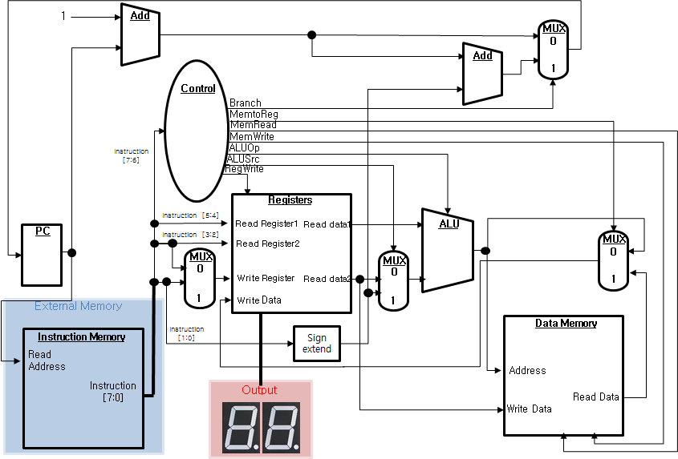
Microprocessor Design – Interface of Microprocessor components
Program Counter
Indicates the address of instructions. Initially, PC is set to start address as zero.
Register
Consists of four 8-bit general purpose Registers.
Write data to Register or output the read data from Register according to control inputs.

Slide 9
Microprocessor Design – Interface of Microprocessor components
Instruction [7:0]
Address [7:0]
Instruction Memory
Instruction size : 8-bit
# of instructions : 4 (add, load, store, jump)
It has pre-defined instructions. Each instruction is 8-bit long. 2 MSBs are the instruction, remaining LSBs are used for different purpose. (Refer to ISA format)
# of input ports : 8 (8-bit Instruction Address)
# of output ports : 8 (8-bit Instruction Register)
Assume Instruction Memory for test. Instruction Memory will be given by external memory on evaluation by TA.

Slide 10
Microprocessor Design – Interface of Microprocessor components
Control Unit
Manages the process of moving data and instruction.
Get 2-bit operation as input and outputs 1-bit control signals (Refer to Control Signal Table)
ALU
Performs add operation (don’t care ‘overflow’)
Two operands (such as Rs, Rt, offset of I-type instructions)

Slide 11
Microprocessor Design – Interface of Microprocessor components
Data Memory
[0] 0
[1] 1
[2] 2
[3] 3
...
[14] 14
[15] 15
[16] 0
[17] -1
[18] -2
[19] -3
...
[30] -14
[31] -15
Data Memory
8-bit address, # of data : 256 But, because of the total capacity of the FPGA we use, we will use only 32 of 8-bit registers
Initialize the data memory like above. This means, when you press 'Reset' button, data should be like above. (hint: use always block sensitive to reset signal.)

Slide 12
Microprocessor Design – Interface of Microprocessor components
Output 7 segment display
Two 7 segment displays that show the contents of Register for Reg Write Data in Hexadecimal.

Slide 13
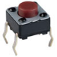
Microprocessor Design – Interface of Microprocessor components
Instruction Memory
Microprocessor
Read Address
PC
RST
FPGA
FPGA
50MHz Oscillator
Instruction
Instruction
LED1
LED2

Slide 14
Example test set : Input
The actual machine instructions
stored in Instruction Memory
Instructions
signed value in
2’s complement.
Refer to ISA
[1] lw $s1, 0($s0) // 2’b01 2’b00 2’b01 2’b00
[2] lw $s2, 1($s0) // 2’b01 2’b00 2’b10 2’b01
[3] add $s0, $s1, $s2 // 2’b00 2’b01 2’b10 2’b00
[4] sw $s2, 1($s0) // 2’b10 2’b00 2’b10 2’b01
[5] j -1 // 2’b11 2’b00 2’b00 2’b11
Data stored in
Data Memory
Data Memory
[0] 0
[1] 1
[2] 2
[3] 3
…

Slide 15
Example test set : Output
Result
Reg Write data in Register becomes 2 (ALU result. But don’t care)
PC is fixed as 4 (infinite loop)
Data Memory’s memory [2] becomes 1
Register
Data Memory
4
[0] 1
[1] 0
[2] 1
[3] 0
[0] 0
[1] 1
[2] 1
[3] 3
PC
…
Reg Write data : 1

Slide 16
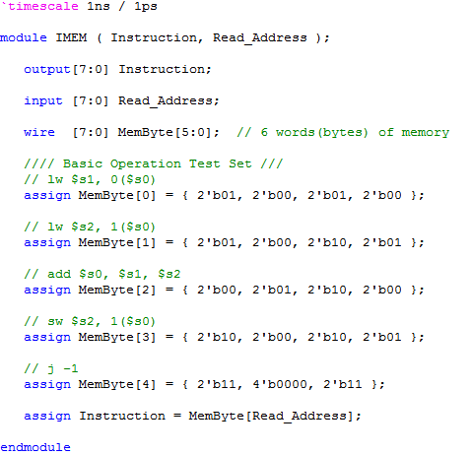
Test Environment

Slide 17
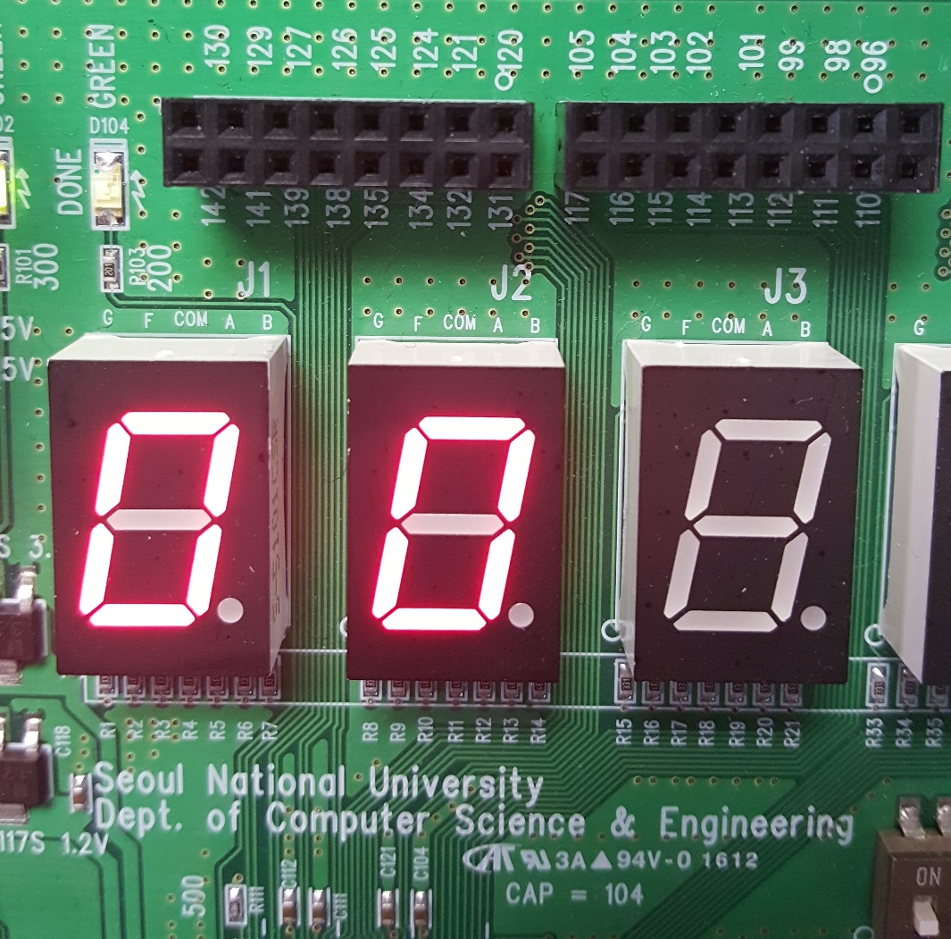
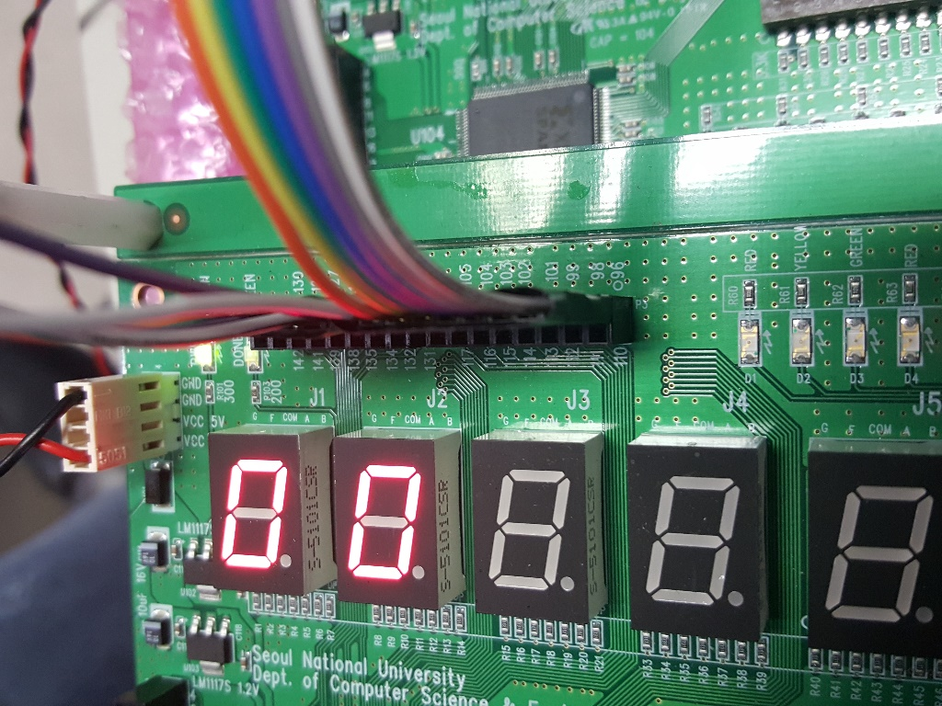
Test Environment
Instruction[7:0]
Read_Address[7:0]
Reg_Write_Data
[7:4]
Reg_Write_Data
[3:0]

Slide 18
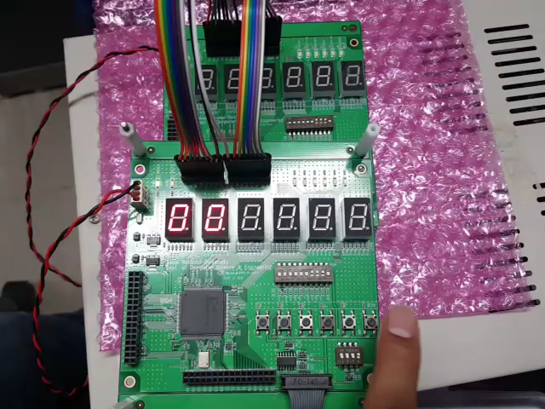
Test Environment
Cable will be available in material cabinet after June 7th
(Or you can make your own)

Slide 19
Project Grading
Report (individual) (40%)
Explain the overall design and structure in detail
Specify the functionality of each module in your implementation
Verify your implementation is correct with simulation result
Completeness (60%)
Sets of Test Instructions (testing from basic operations to combinations of operations) will be tested
Extra credits (5%)
Basic functions + “alpha”
Extra implementation that we can see when grading your project score. Any useful extra implementations, such as Register status displays or operation displays etc., are okay

Slide 20
Project Grading
Date : June 19th, Tue
Time : 15:30
Location : B302 R310-2
Report & Code Submission : until 19th, June. 15:30 via e-mail
FPGA Submission : right after the test. If the FPGAs are broken or missing, you will get the 20% penalty of your final project.

Slide 21
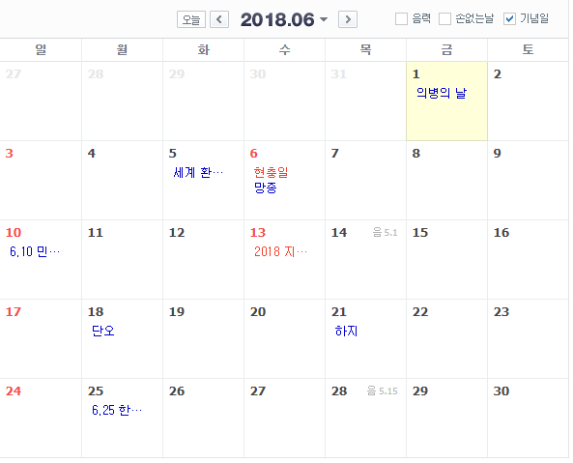
Calendar
Today
Final
Exam
Project
Due

Slide 22
End
한 학기 동안 고생 많으셨습니다

